Slide 1
Sharon Taylor-Booth Parish Finances and Treasurer Support

Slide 2
Finance Department
Head of Finance: Nigel Strange Ext241 nigel.strange@chester.anglican.org
Assistant Accountant: Sharon Taylor-Booth Ext 262 M: 07752 798149 sharon.taylorbooth@chester.anglican.org
Finance Officer: Gill Ellis
Ext 242 gill.ellis@chester.anglican.org
Office Manager & Finance Assistant: Emma Hathaway Ext 246 emma.hathaway@chester.anglican.org
Finance and HR Officer: Maxine Southwick Ext 239 M: 07701 325223 maxine.southwick@chester.anglican.org

Slide 3
Parish Finances
Parish Share
Fees
Stipend & Housing Allowances
Grant Payments
Trusts
Treasurer Support

Slide 4
Parish Share
Standard Parish Share
Parish Banding
Clergy Number

Slide 5
Fees
Monthly
Can be paid by
Cheque, Bank transfer, Direct Debit
Fees@chester.anglican.org

Slide 6
Stipend & Housing Allowances
Paid centrally
Housing Allowances recovered from the parish

Slide 7
Trusts
Permanent Endowments
When trusts can be released
How trusts can be released

Slide 8
Treasurer Support

Slide 9
Treasurer Network
Who does it aim to reach ?
Treasurers
Finance Teams
Church Wardens
PCC Members
Clergy

Slide 10
Treasurer Network
What does it aim to achieve ?
Equip
Support
Connect

Slide 11
Treasurer Network
How will it achieve this ?
Monthly Meetings
News Letters
Sign Posting
Adhoc Gatherings

Slide 12
Treasurer Network
What does the network look like ?
Some individuals Parish Support
Access to an Accounting Package
Connections made with other Parishes
Page on Chester DBF Website

Slide 13
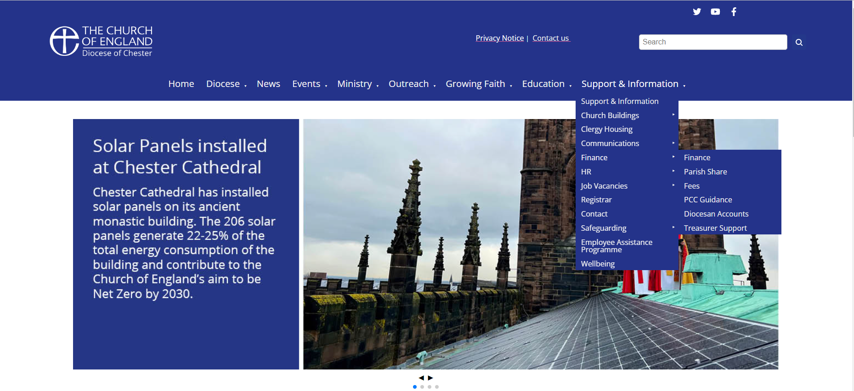

Slide 16
