Slide 1
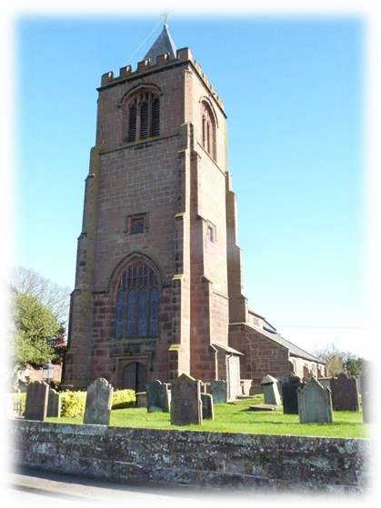
Diocesan Advisory Committee for the Care of Churches
Faculty Jurisdiction
- runs parallel to secular planning
- need for parity with secular planning system if the Church is to retain Ecclesiastical Exemption

Slide 2
Types of permission
List A – minor works with no permission needed – if in doubt ask
List B – Archdeacon’s permission - proposals usually need review
Faculty – needs consideration by DAC, and is approved by the Diocesan Chancellor
Submitted via the Online Faculty System

Slide 3
DAC consists of:
Chair
Archdeacons
Clergy members
Architect members
Lay members
Supported by a range of Advisers, eg heating, archaeology
DAC office staff:
DAC Secretary – Caroline Hilton
Assistant to DAC Secretary – David Bayley

Slide 4
What the DAC does…
Scope – church buildings, churchyards, boundary walls, structures in churchyards
Considers faculty applications and requests for informal advice
Provides informal feedback to parishes and formal advice to the Chancellor
Site visits – formal or informal

