Slide 1
Diocesan Advisory Committee for the Care of Churches
Introduction to the DAC

Slide 2
Introduction to Faculty Jurisdiction
Faculty Jurisdiction has existed since 19th century
Ecclesiastical Exemption means the Church has control over works to church interiors through Faculty Jurisdiction
A faculty is a legal permission – required for works to a church building or churchyard that include changes
Faculty Jurisdiction runs parallel to secular planning
Need for parity with secular planning system if the Church is to retain Ecclesiastical Exemption

Slide 3
Types of permission
List A – minor works with no permission needed – if in doubt ask
List B – Archdeacon’s permission - proposals usually need review
Faculty – needs consideration by DAC, and is approved by the Diocesan Chancellor
Submitted via the Online Faculty System

Slide 4
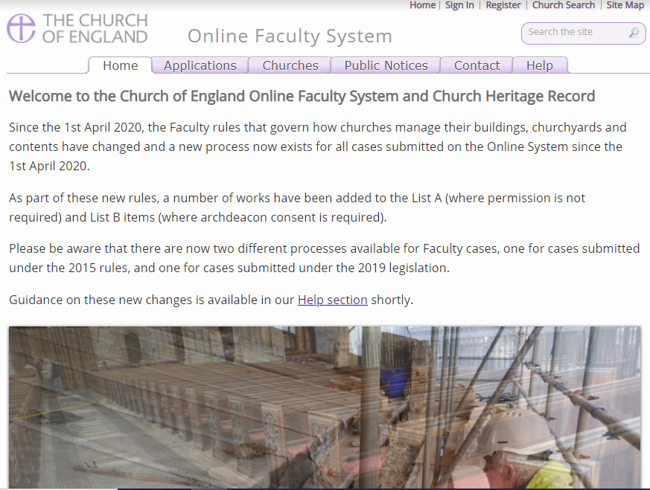
Record List A works
Submit requests for List B works
Submit faculty applications
Submit requests for temporary minor re-ordering
DAC office is happy to help

Slide 5
Diocesan Advisory Committee for the Care of Churches
Chair
Archdeacons
Clergy members
Architect members
Lay members
Helped by advisers on items such as heating, organs, clocks, bells, stained glass, archaeology
DAC office staff
DAC Secretary – Caroline Hilton
Assistant to DAC Secretary – Katy Purvis

Slide 6
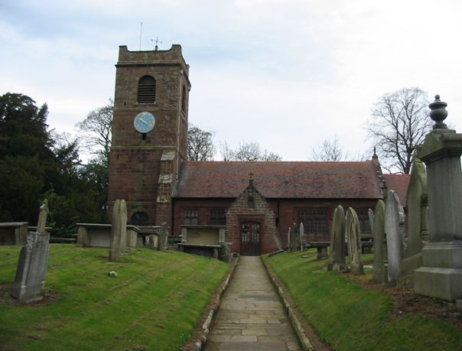
The DAC considers…
Church buildings
Churchyards
Boundary walls
Trees in churchyards
Structures in churchyards
Church halls within the curtilage of the church building

Slide 7
What the DAC does…
Around 9 meetings per year of the full DAC
Considers faculty applications
Considers requests for informal advice
Provides informal feedback to parishes
Provides formal advice to the Chancellor

Slide 8
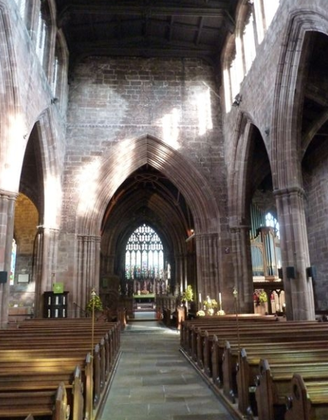
Site visits
DAC Sub-committee: consists of Chair, Architect, Clergy member and Archdeacon if available. Reports back to full DAC and feedback offered to parish.
Informal visit: DAC Secretary (sometimes alongside Church Buildings Missioner or a DAC Architect) for chat at the early stages, eg to think about Statement of Need, and to outline the process and any need for consultation

Slide 9
Quinquennial inspections
Requirement for churches to be inspected every five years
Quinquennial inspection report is a key document assisting the PCC in its care and repair of church building
Parish need consult the DAC regarding their choice of inspector
Choice of architect should be with due regard to the Church Buildings Council guidance regarding their accreditation and experience depending on the grade listing of the church
DBF pays the quinquennial inspection fee

