Slide 1
Introduction Implementing the Vision
Jon Pocock
Strategic Programme Director

Slide 2
Outline
Introductions – who am I?
Vision Process & Outcomes
What next?
Strategic
Programme
Director

Slide 3
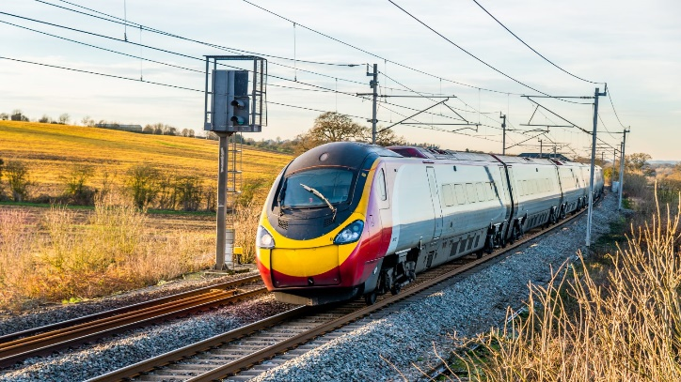
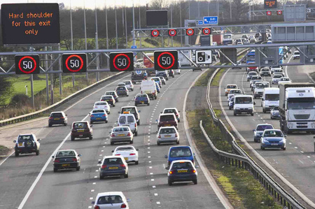
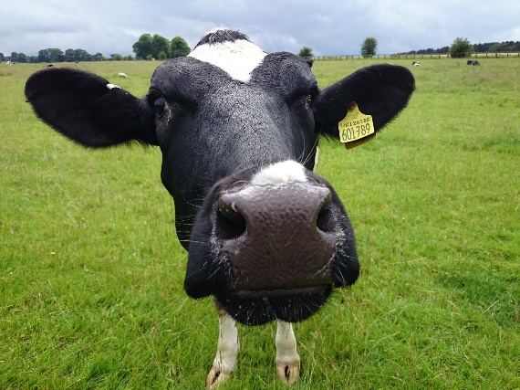
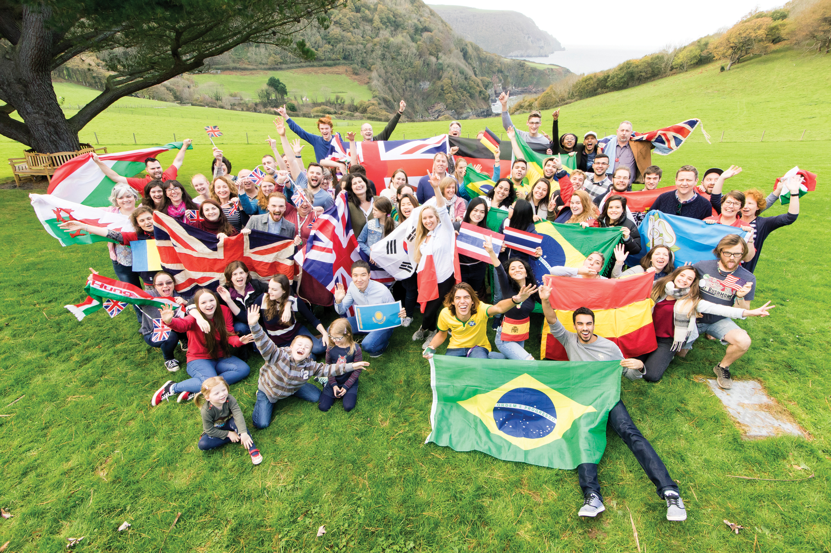
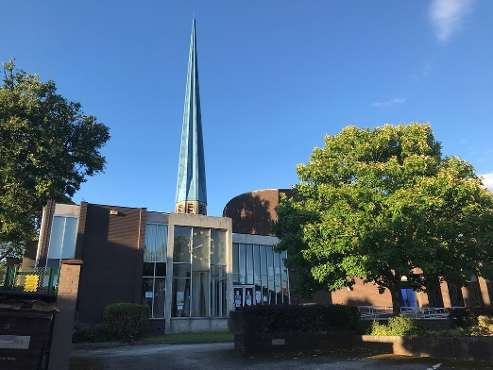
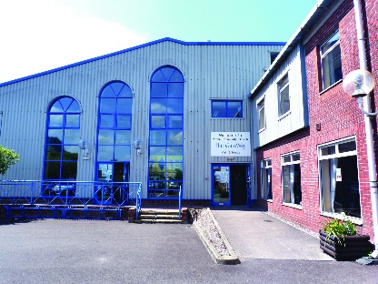
Professional Engineer
Consultant
Worship Leader/
Churchwarden
Music / Creative Arts
Director
Operations Director
Who is Jon?

Slide 4
Process
Consultation “Casting the Net Wide”
Agreed
Review
Vision:
Vision Casting
Consultation across the diocese
Small Team
Bishop’s Council
Diocesan
Synod
Harriet Roberts: Director of Development - Vision and Strategy

Slide 5
Outcomes: Priorities
We believe in the Gospel.
We believe in the local and seek transformation.
We care about the environment, locally and globally.
We want to engage with young people and the ‘disconnected’.
We want to do bigger, better, bolder things together simply.
The 1.5 million people in our diocese matter.
We want to build new communities of faith.
Together in Christ
Sharing Hope
Outcomes: Vision
Growing braver, fuller faith
Blessing 1.5 million lives, one life at a time
Transformative loving service (in practice)
Engaged locally, working together in loving generosity

Slide 6
Process
Consultation “Casting the Net Wide”
Agreed
Review
Vision:
Vision Casting
Consultation across the diocese
Small Team
Bishop’s Council
Diocesan
Synod
Agreed
Development
Development
Review
Implementation
Strategy:
Small Team
Bishop’s Council
Diocesan
Synod
Jon Pocock: Strategic Programme Director

Slide 7
Strategic Programme
Director
What does that mean?
Standing back and seeing the bigger picture
Identifying how things interact
Working out the best ways to work towards our vision

Slide 8
Strategic Programme
Director
What does that mean?
Sometimes we will need to start small, and build our capacity
Sometimes there will be multiple ways, and we need to fit around other things
Sometimes we need to share our different gifts and skills and collaborate
Sometimes we will achieve far more together if we are generous and don’t hoard our gifts

Slide 9
Strategic Programme: Process
Director
Encourage
Local Vision
What do we do now?
What is God calling us to do?
Short, simple projects
Demonstrations of what is possible
Encouragements that we can succeed
Easy wins
Clear projects
Definitions
Focus
Resources
Delivery
Areas to explore
Analysis
Choices
Who, What, Where, When, How?
Simplest, Most impact, Most easily replicated/transferred
Emerging Ideas
?? - Learning / refocusing as we go along
Sharing & Celebrating
Telling stories – Learning from each other

Slide 10
Strategic Programme: Variety
Director
External Resources
Existing Parish Initiatives
New/Growing Parish Initiatives
Church House
Diocesan Resources
Encouraged Initiatives
Innovation / collaboration
Focused support
Coordinated support
Parish
Parish
Ideas
Resources
Training
Parish
Parish
Local
Resources
School
Local
Resources
School
Local
Resources
Under-pinning support
Advice / good practice / networks

Slide 11
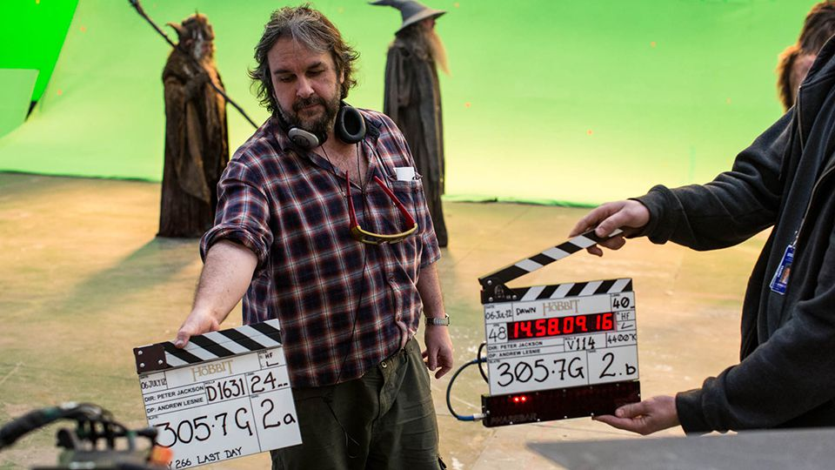
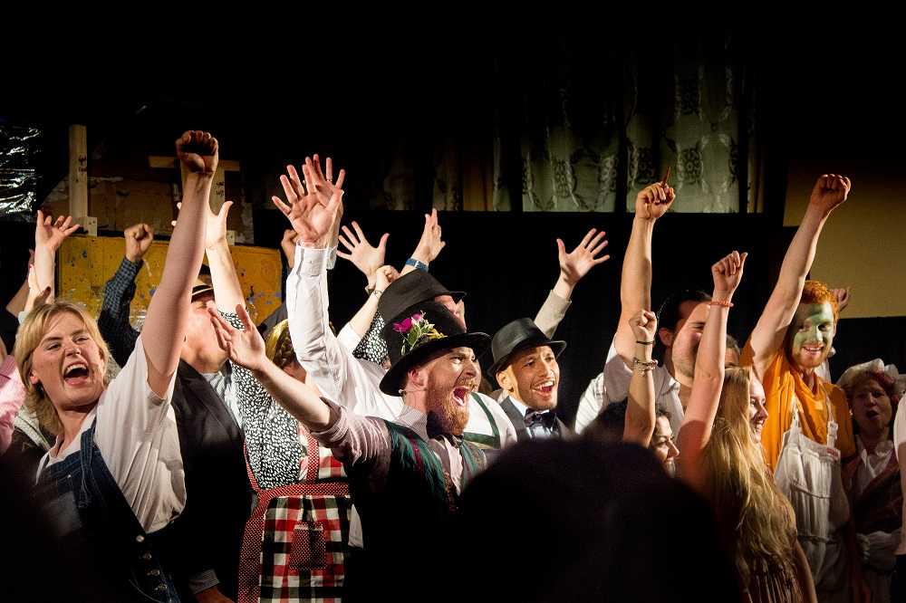
Strategic Programme
Director
Finding the best way to tell the story
Encouraging everyone to work together
Matching people to the best roles/jobs so they shine
Drawing out the extra-ordinary from ordinary people

Slide 12
Implementing the Vision Questions
Jon Pocock
Strategic Programme Director

